Slide 1
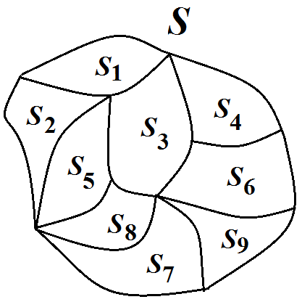
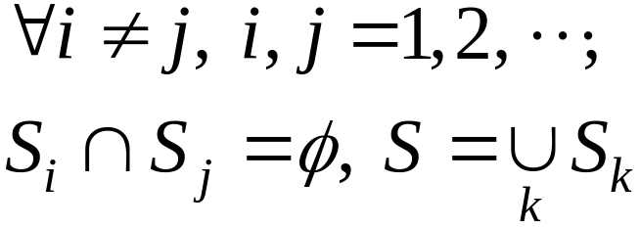
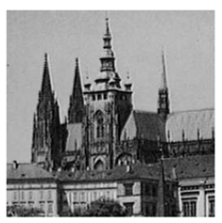
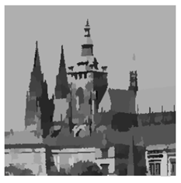
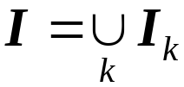
Chapter 9: Image Segmentation
– Partition an image into component parts
。 Mathematical Partition
。 Image Segmentation
Image
I
Segmentation
9-<number>

Slide 2
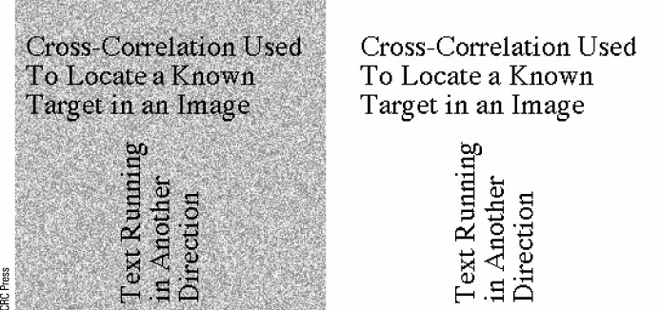
。Advantages:
(i) Remove unnecessary details
(ii) Bring out significant portions
Example:
9-<number>
Notes:
兩個目的:
1.去掉不重要detail
2.彰顯有隱藏之有意義的內容

Slide 3
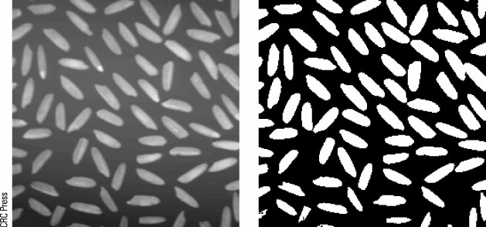
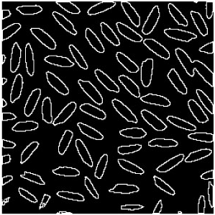
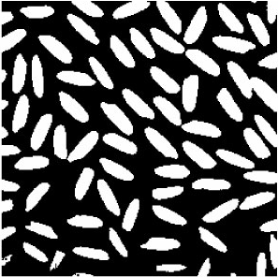
Fundamental approaches:
(1) Thresholding
(2) Edge detection
9-<number>

Slide 4
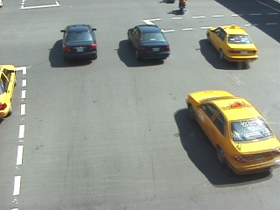

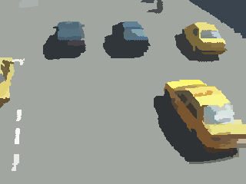
(3) Region-based segmentation
Split
Merge

Slide 5
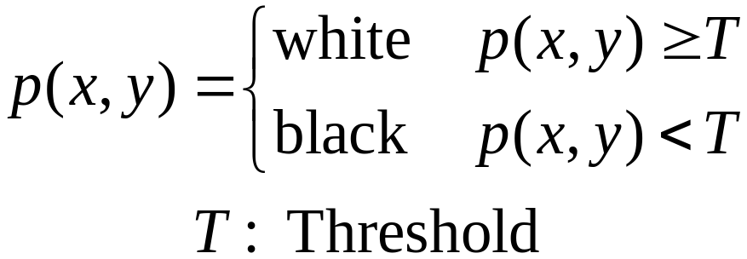
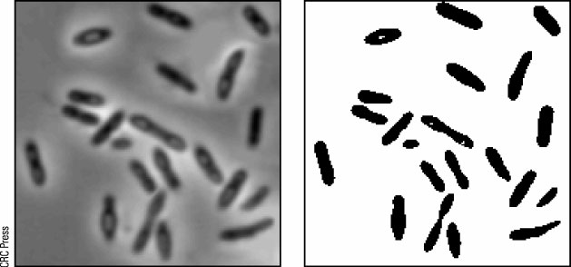
◎ Thresholoding
。 Single Thresholoding
Example:
9-<number>

Slide 6
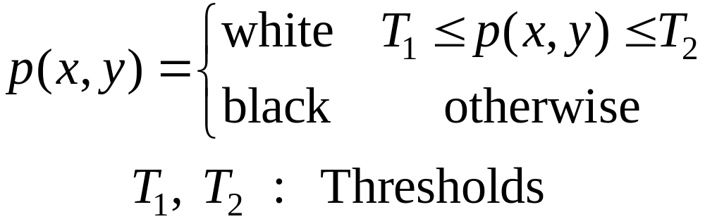
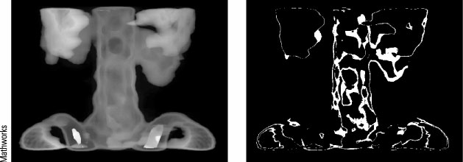
。 Double Thresholding
Example:
9-<number>

Slide 7
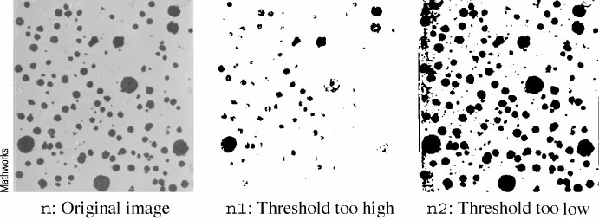
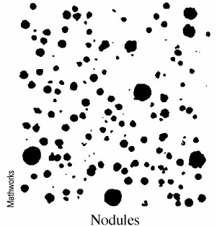
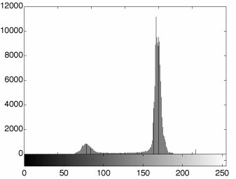
○ How to choose a threshold value
。 Histogram method
9-<number>
Notes:
high low調換

Slide 8
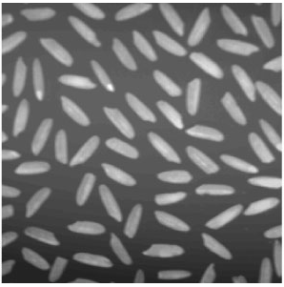
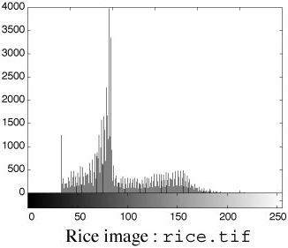

。 Otsu’s thresholding method
Describe the histogram as a probability
distribution by
9-<number>
Notes:
整張影像決定一threshold

Slide 9
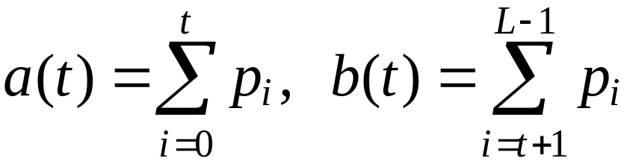
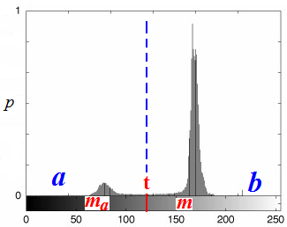
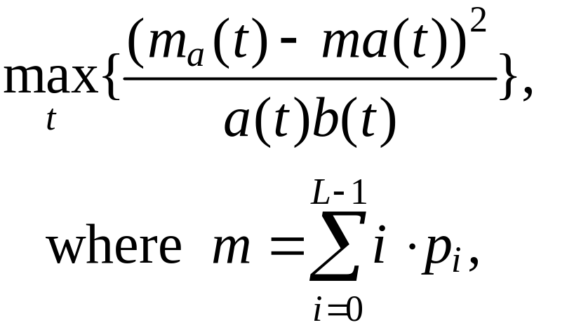
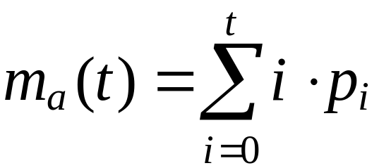
Let t be the determined threshold value
(t unknown so far).
Define
Find t such that
9-<number>
Notes:
m-整體平均值
ma-a部分平均值
令導數=0可求最大,但變數在index無法微分,只能一個一個找(其中一個方法是從ma找到m)

Slide 10
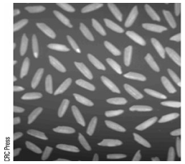
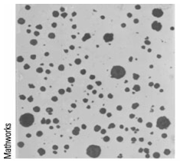
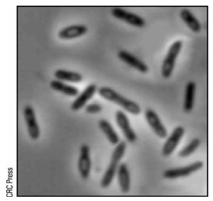
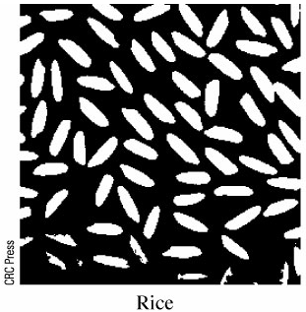
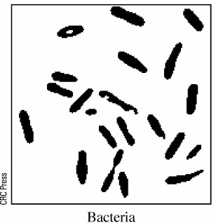
9-<number>
Notes:
nodules-
疣

Slide 11
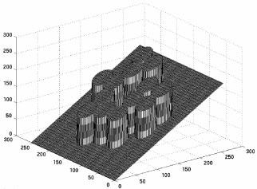
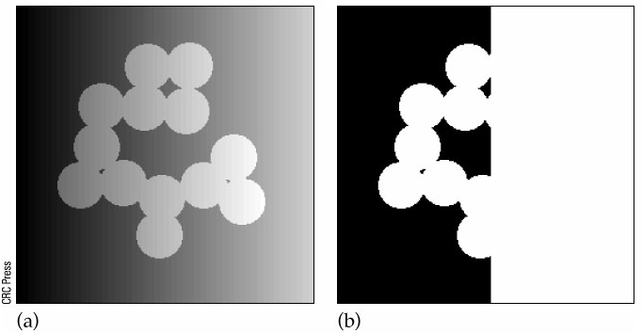
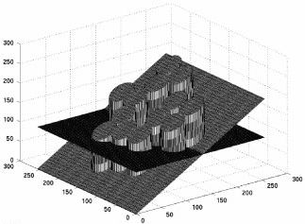
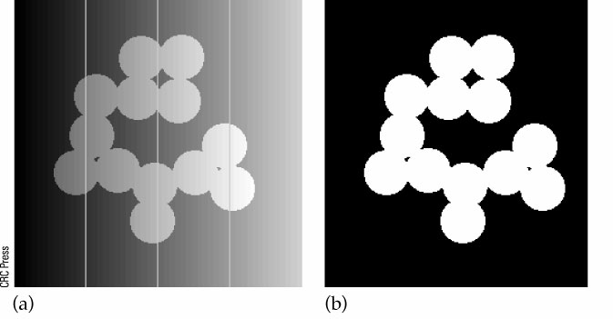
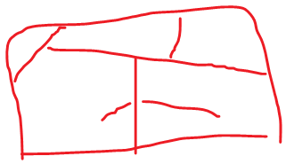
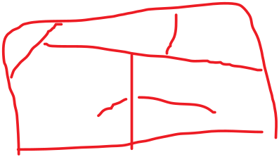
Adaptive Thresholding
Divide image into strips
Apply Otsu’s method to each strip
9-<number>
Notes:
分割影像,對每個分割用otsu決定threshold
分太少,會向上面一樣, 分太多,處理上太慢。

Slide 12
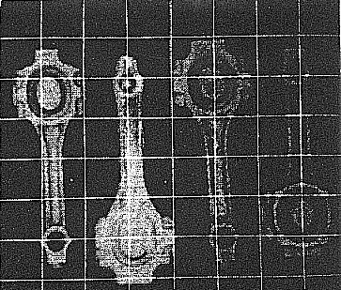
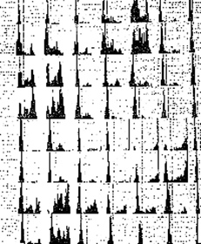
。 Variable thresholding
(i) Divide image into blocks
(ii) Compute histograms
of block images
9-<number>
Notes:
每個pixel決定一個threshold(把各block視為中心點,用其threshold 進行bilinear interpolation)
應該每個小histogram要轉向

Slide 13
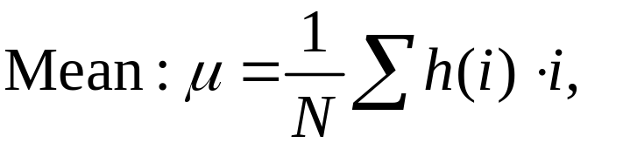
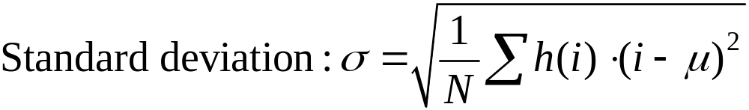

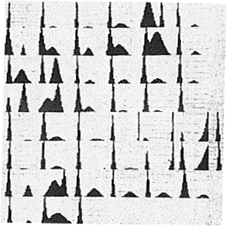
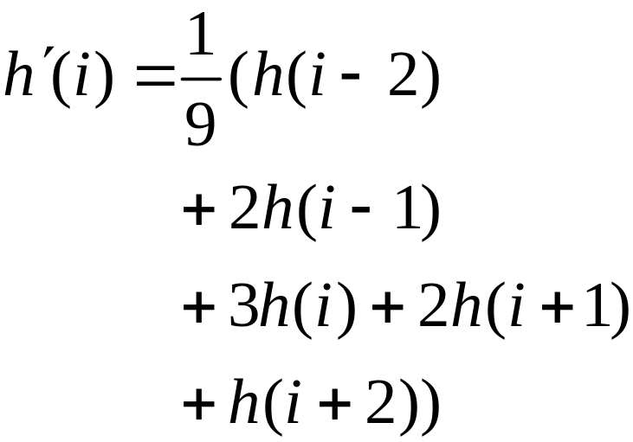
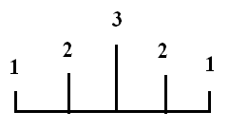
For each block image, compute its
(1) Smooth histogram h
9-<number>

Slide 14

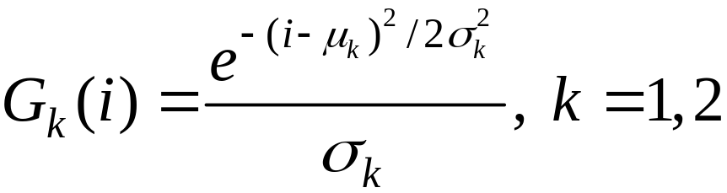

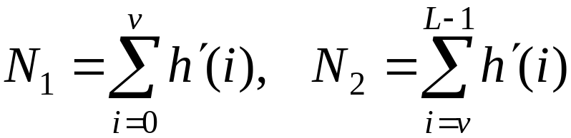
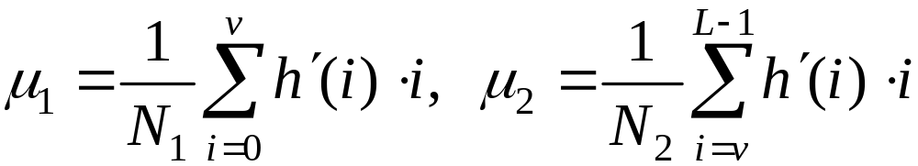
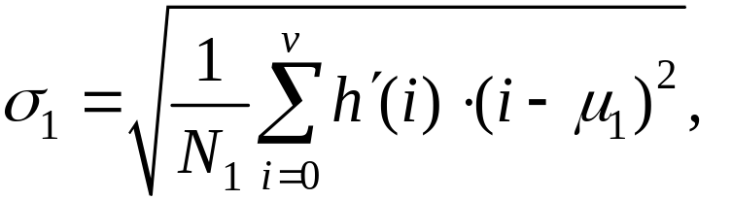
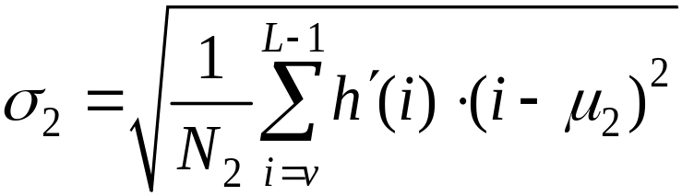
(2) Fit with mixture of Gaussian
EM algorithm
9-<number>
Notes:
em algorithm 蠻複雜(ml會學到)

Slide 15
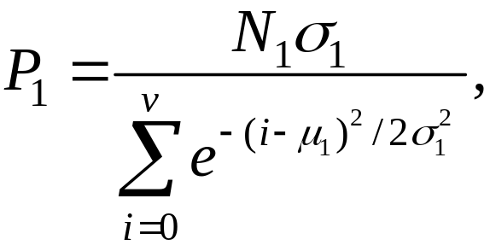
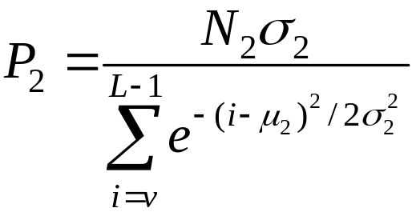


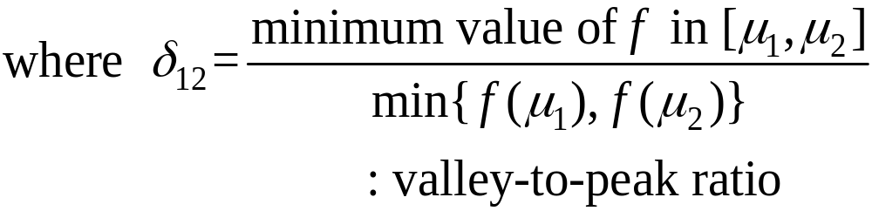

where v is the gray level corresponding to the deepest valley of
(3) Test bimodality
9-<number>
Notes:
miu1-miu2>t2(看距離遠不遠)
t3<sigma1/sigma2<t4(分散程度相差大不大)

Slide 16



(4) If the bimodality test is past, compute T by
(5) For block (x,y) whose threshold value T(x,y)
hasn’t yet been determined
9-<number>
Notes:
決定完block的threshold 還要決定每個pixel的threshold

Slide 17



(6) Smooth T by
(7) Determine thresholding
values of image pixels
by bilinear interpolation
9-<number>

Slide 18


Global thresholding
Variable thresholding
9-<number>

Slide 19









◎ Edge Detection
。 Types of edge:
Step edge (jump edge)
Ramp edge
Roof edge (crease edge)
Smooth edge
9-<number>
Notes:
ramp edge/roof edge:+代表亮,負代表暗
smoothe edge:正代表逆時針,負代表順時針

Slide 20

9-<number>

Slide 21



○ Derivatives
9-<number>
Notes:
影像微分:
作法-隔壁(可以緊鄰也可以隔好幾個)相減

Slide 22



2-D case:
9-<number>
Notes:
有方向的圖-needle(針)圖

Slide 23

9-<number>
Notes:
gradient分成8個方向來處理

Slide 24






Prewitt filters (central derivative + smooth)
。Consider
Horizontal filter: , Smooth filter:
Combine
Vertical filter: , Smooth filter:
Combine
9-<number>

Slide 25



vertical
horizontal
Edge image Binary image Thinning
9-<number>
Notes:
Thinning(稍微高階alog)-較複雜,先不談

Slide 26




。Roberts filter:
。Sobel filter:
9-<number>

Slide 27




◎ Second Derivatives
Laplacian:
9-<number>

Slide 28



Laplacian Filter:
Invariant under rotation (isotropic filter)
9-<number>

Slide 29


Step edge:
Ramp edge:
9-<number>

Slide 30


。 Second derivatives are
sensitive to noise
。 Other Laplacian masks
9-<number>

Slide 31



○ Zero crossing
0 +, + 0
0 －, － 0
+ －, － +
9-<number>
Notes:
要注意跨過零的點(zero-crossing point)

Slide 32


Example: Edge detection by taking zero
crossings after a Laplace filtering
Marr-Hildreth method
Smooth the input image using a
Gaussian before Laplace filtering
9-<number>
Notes:
Laplace filterin很麻煩(zero-crossing point 難找)

Slide 33



。 Gaussian smooth + Laplace filtering
= Laplacian of Gaussian (LOG):
Gaussian:
LOG:
9-<number>

Slide 34


Mexican hat:
Difference of Gaussian (DOG):
9-<number>
Notes:
DOG-需要G1,G2
Laplacian of Gaussian-只需一個G

Slide 35






◎ Canny edge detector
○ Steps: Let
1. Smoothing and Edge detection
(a) Horizontal direction
(b) Vertical direction
(c) Edge magnitude
9-<number>

Slide 36







2. Non-maximum suppression
(a) For each pixel p,
(b) Quantize to
0, 45, 90 or 135 degs.
(c) Along
p is marked if its edge magnitude
is larger than both its two neighbors
p is deleted otherwise
9-<number>
Notes:
Quantize完以後,才有鄰近垂直之兩點可以考慮

Slide 37



3. Hysteresis thresholding
For each marked pixel p,
(a) If > or
(b) If and p is adjacent to
an edge pixel
p is considered as an edge pixel
9-<number>
Notes:
Hysteresis-遲滯現象
canny 強調他的edge只有一個pixel的寬度

Slide 38





◎ Hough Transform
9-<number>
Notes:
image transformation
Hough Transform-把影像轉換到參數空間(spatial→frequency)
Fourier transform-把影像轉換到頻率空間(spatial→parameter)
wavelet
haar

Slide 39









○ Line equation: y = ax + b
A point on the line
Rewrite as
Another point
on the line
Parameter space
9-<number>
Notes:
若ax+by=0的話b不可以=0
spatial domain上每一點對應parametric domain一條線,一次取兩點, 得兩條直線,再取其交點
故交點密集的地方代表spatial domain 上有很多斜率接近的直線
在parametric doamain圖上取cluster之平均值後在原圖(spatial domain)construct 直線

Slide 40



○ Line equation in the polar coordinate system:
9-<number>

Slide 41
◎ Region-based Segmentation
○ Splitting and Merging
Split
Merge

Slide 42
Steps:
1. Equally divide the input image into 4
sub-images;
2. Compute the characteristics of each sub-image,
e.g., intensity, color, texture, variance, etc;
3. Repeatedly divide sub-images into
sub-sub-images if their characteristics are
significantly different;
4. Repeatedly merge adjacent sub-images if
their characteristics are similar enough.

Slide 43





Slide 44






Input Image
Region Boundary
Segmentation

